Slide 1

x
B.Tech Major Project Presentation-2017
DEVELOPMENT OF PATH FOLLOWING CONTROLLER FOR CONTROLLING THE TWO LINK MANIPULATOR
By
Saradashree Patra Roll-201311219
Swapna Rani Kuanr Roll-201311074
Under the guidance of
Dr. Basant Kumar Sahu
Saradashree Patra(Roll # 201311219) & Swapna Rani Kuanr(Roll#201311074)

Slide 2


B.Tech Major Project Presentation-2017
CONTENTS
Introduction
Objective of the project
Kinematics and dynamics analysis
Development of controllers
Advantages
Disadvantages
Future scope
Conclusions
References
National Institute of Science & Technology
Saradashree Patra(Roll # 201311219) & Swapna Rani kuanr(Roll # 201311074)

Slide 3
B.Tech Major Project Presentation-2017
INTRODUCTION
Robotics is a complex field involving many diverse disciplines, such as physics, properties of materials, statics and dynamics, electronics, control theory, vision, signal processing, computer programming, and manufacturing.
Robots have been used at the workstation level to perform operations such as assembly, drilling, surface finishing, welding, palletizing, and so on.
National Institute of Science & Technology
Saradashree Patra(Roll # 201311219) & Swapna Rani kuanr(Roll#201311074)

Slide 4
B.Tech Major Project Presentation-2017
MOTIVATION
By referring a number of research, articles and books we came to know that the path following controller of two link robotic manipulator(TLRM)is an important and popular research topic in recent era.
This lecture motivated us to develop an path following controller for two link robotic manipulator.
National Institute of Science & Technology
Saradashree Patra(Roll # 201311219) & Swapna Rani Kuanr(Roll#201311074)

Slide 5
B.Tech Major Project Presentation-2017
OBJECTIVE OF THE PROJECT
The objective is to develop the path following controller which will be able to make a robotic manipulator follow the reference path.
The reference path is defined as a function of the parameter that has dynamics.
Using this parameter, we can define the contour error, which is the error that enables us to measure the distance from the reference path to the configuration of the robot.
National Institute of Science & Technology
Saradashree Patra(Roll # 201311219) & Swapna Rani Kuanr(Roll#201311074)

Slide 6
B.Tech Major Project Presentation-2017
KINEMATICS ANALYSIS
Define vectors corresponding to the two links:
r₁₌l₁ [cos (θ₁), sin (θ₂)]
r₂₌l₂ [cos (θ₁+θ₂), sin (θ₁+θ₂)]
The position of the tip r can be found simply by vector addition.
x = l₁ *cos (θ₁) + l₂*cos (θ₁+θ₂)
y =l₁*sin (θ₁) + l₂*cos (θ₁+θ₂)
Saradashree Patra(Roll # 201311219) & Swapna Rani Kuanr(Roll#201311074)

Slide 7
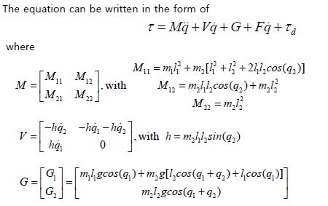
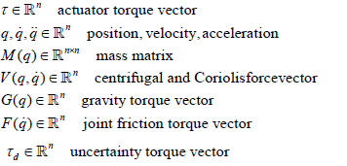
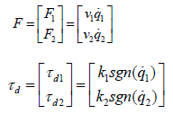
B.Tech Major Project Presentation-2017
DYNAMIC ANALYSIS
Saradashree Patra(Roll # 201311219) & Swapna Rani Kuanr(Roll#201311074)

Slide 8
B.Tech Major Project Presentation-2017
2 Link Planar Manipulator
x₂
y₂
Frame 0 – ground reference
Frame 1 – link 1, distal end
Frame 2 – link 2, distal end
Length of Link 1 = a₁
Length of Link 2 = a₂
Note: coordinate systems are consistent with the Denavit-Hartenburg system
O₂
y₀
a₂
y₁
θ₂
x₁
a₁
O₁
θ₁
x₀
O₀
Saradashree Patra(Roll # 201311219) & Swapna Rani Kuanr(Roll#201311074)

Slide 9
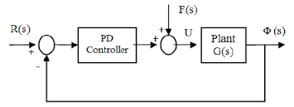
B.Tech Major Project Presentation-2017
DEVELOPMENT OF CONTROLLER
The equation of PD controller is :
ɸ = k_{p}e + k_{d}ė where,
k_{p= Proportional constant}
k_{d= Derivative constant}

Slide 10
B.Tech Major Project Presentation-2017
ADVANTAGES
The major advantages :
Ability to do straight line insertions into furnaces.
Easy computation and programming.
Most rigid structure for given length.

Slide 11
B.Tech Major Project Presentation-2017
DISADVANTAGES
Requires large operating volume.
Exposed guiding surfaces require covering in corrosive or dusty environments.
Can only manipulate the objects in front of it.
Axes of robot are hard to seal.

Slide 12
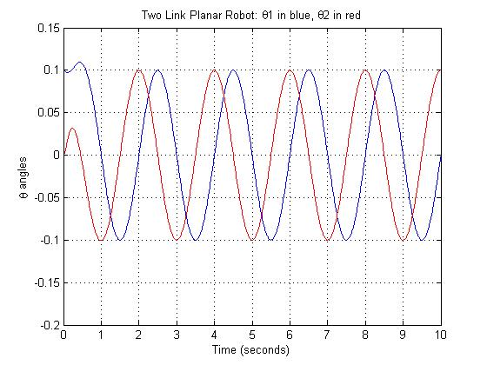
B.Tech Major Project Presentation-2017
RESULTS

Slide 13
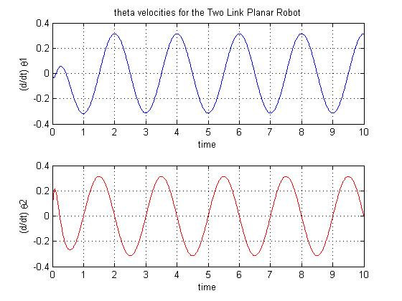
B.Tech Major Project Presentation-2017

Slide 14
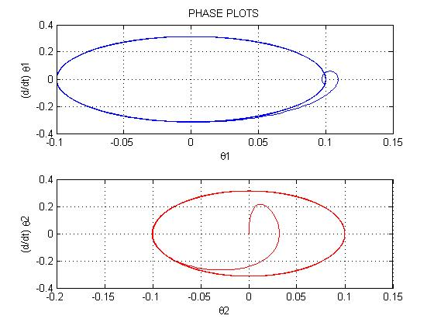
B.Tech Major Project Presentation-2017

Slide 15
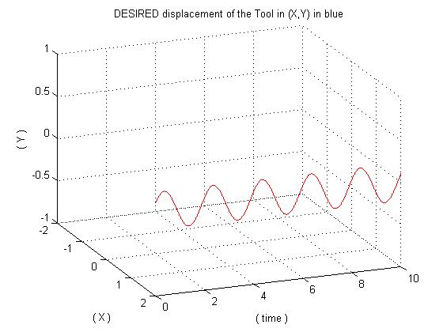
B.Tech Major Project Presentation-2017

Slide 16
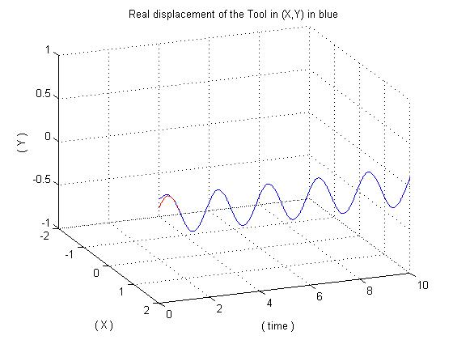
B.Tech Major Project Presentation-2017

Slide 17
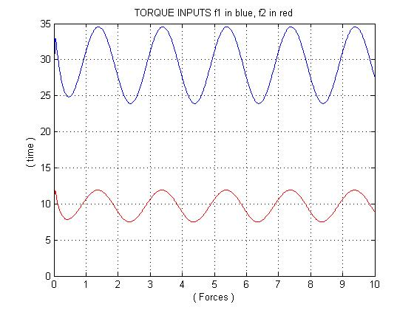
B.Tech Major Project Presentation-2017

Slide 18
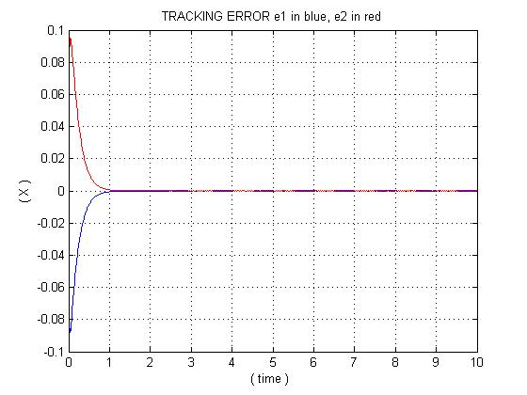
B.Tech Major Project Presentation-2017

Slide 19
B.Tech Major Project Presentation-2017
To develop the path following controller by using sliding mode controller technique.
To verify the results by observing performances of the two link manipulator by the application of intelligent controllers.
To study the efficacy of the controller to be developed, the simulations are to be carried out with the help of MATLAB.
FUTURE SCOPE
Saradashree Patra(Roll # 201311219) & Swapna Rani Kuanr(Roll#201311074)

Slide 20
B.Tech Major Project Presentation-2017
CONCLUSIONS
The Literature survey on two link robotic manipulator has been completed.
By motivating for doing work on the trajectory tracking of Two Link Robotic Manipulator , we have developed the PD controller and are applied on the plant.
From the results it has been surely that the controller is able to provide the exact controlling torque to the arms of the two link robotic manipulator.
Saradashree Patra(Roll # 201311219) & Swapna Rani Kuanr(Roll#201311074)

Slide 21
B.Tech Major Project Presentation-2017
REFERENCES
F. L. Lewis, D. M. Dawson, and C. T. Abdullah, Robot Manipulator Control Theory and Practice, 2nd Ed., Marcel Dekker, Inc. New York, Basel, 2004.
B.K.Sahu, B.Subudhi, “Adaptive Tracking Control of an Autonomous Underwater Vehicle,” Int. Journal of Automation and Computing, vol. 11, no. 3, pp.299-307, 2014.
J. Shah, S. S. Rattan, and B. C. Nakra. "Dynamic analysis of two link robot manipulator for control design using computed torque control."International Journal of Research in Computer Applications and Robotics,vol. 3, issue.1, pp., 52-59, January 2015.
Saradashree Patra(Roll # 201311219) & Swapna Rani Kuanr(Roll#201311074)

Slide 22
B.Tech Major Project Presentation-2017
Thank You
National Institute of Science & Technology
Saradashree Patra(Roll # 201311219) & Swapna Rani Kuanr(Roll#201311074)

